Slide 1
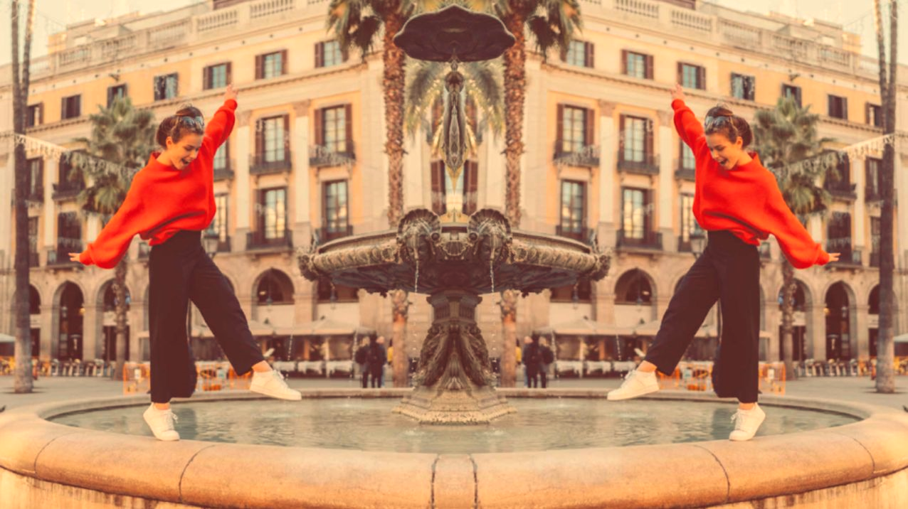


UNIT 6; Lend me your ear
Lesson 7; Famous speeches

Slide 2
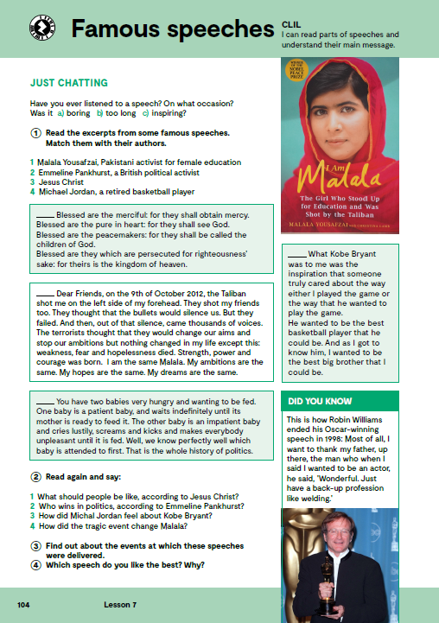
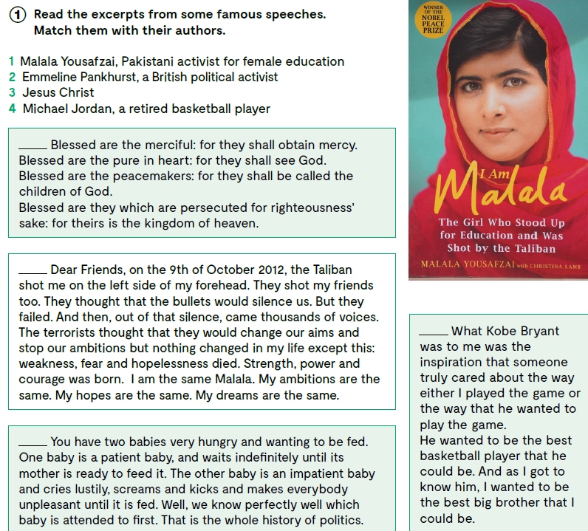
Open your book, page 104.
3
Have you ever listened to a speech?
What was it about?
Have you ever given a speech?
1
4
2

Slide 3
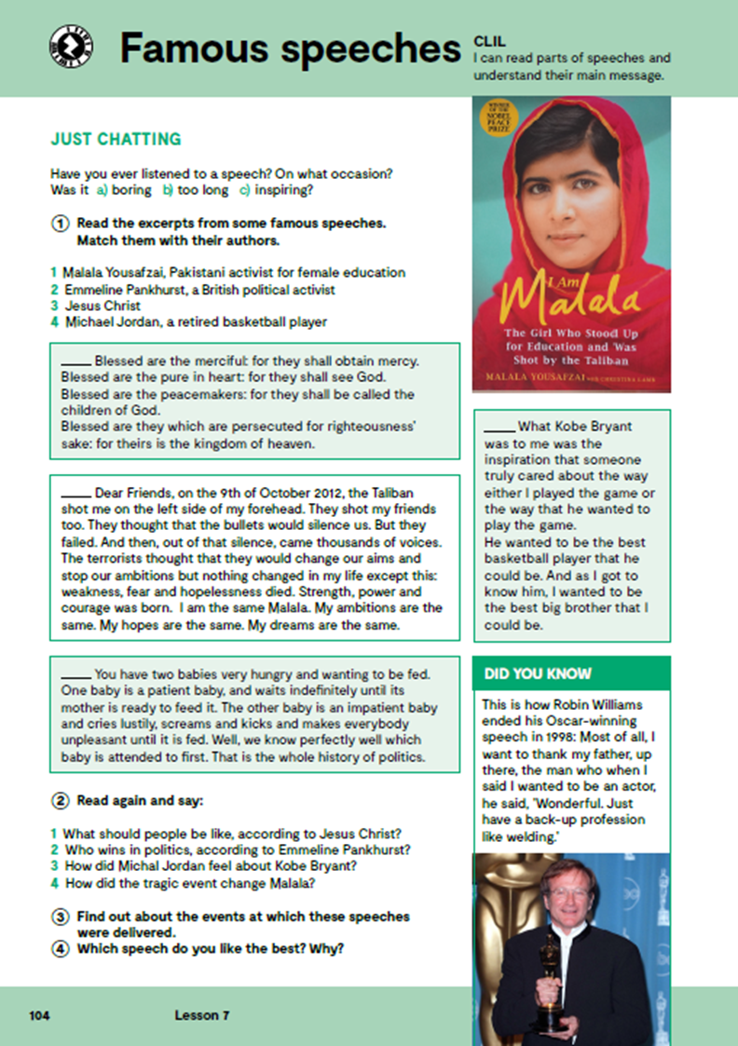
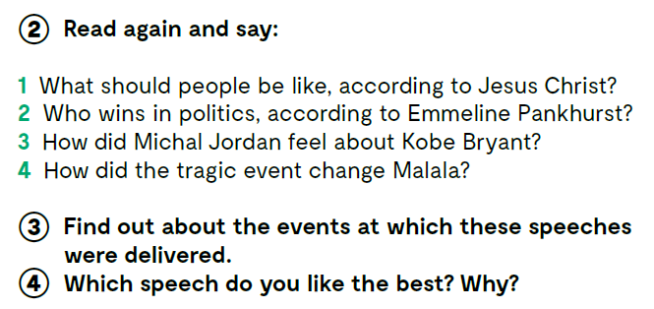

Slide 4
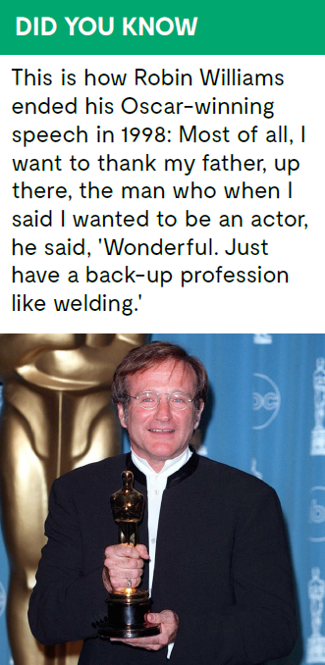

Slide 5
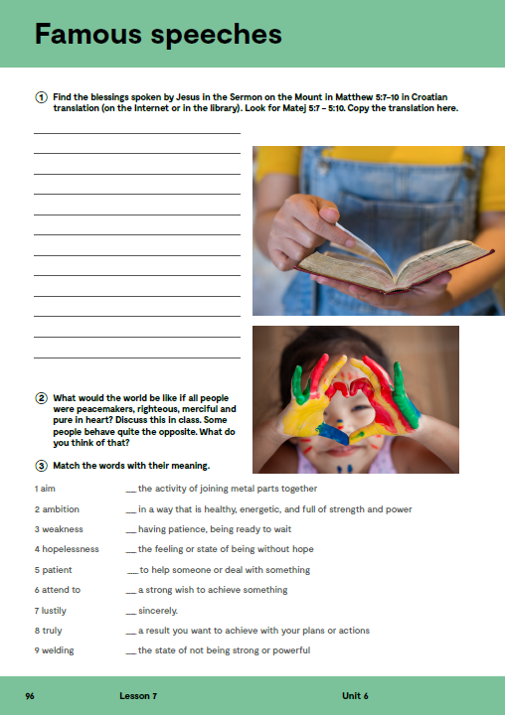
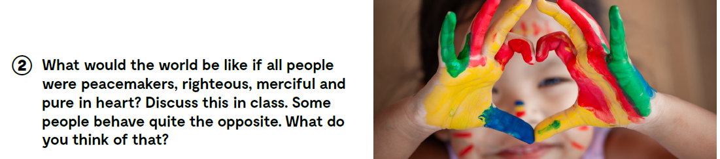
Workbook, page 96.

Slide 6
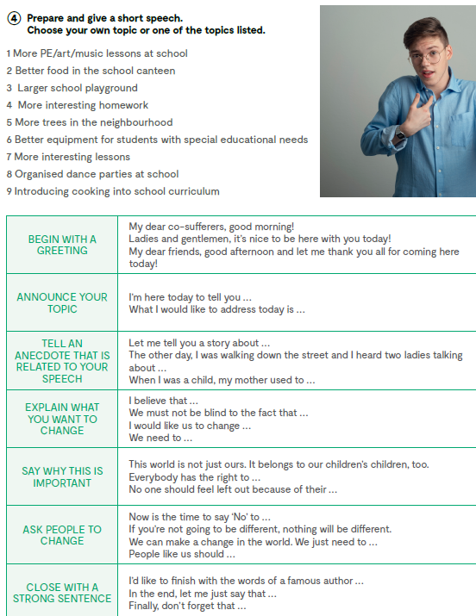
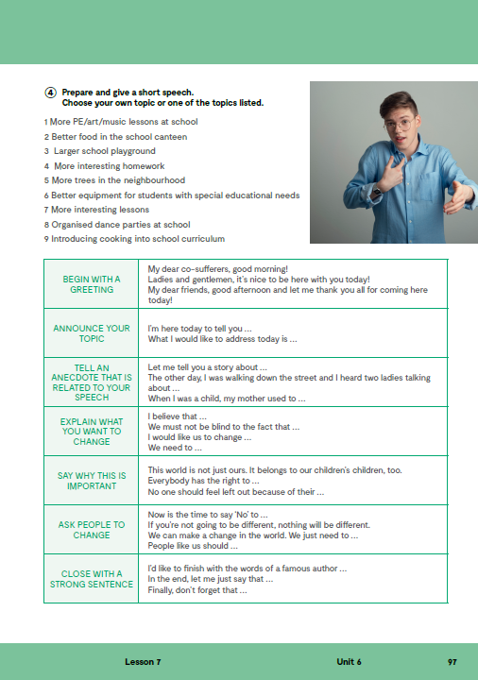

On the next page, page 97.
Open the following link and then click on LEARN MORE! https://www.e-sfera.hr/dodatni-digitalni-sadrzaji/fbb33bd1-df30-4e4a-818d-c257fc0147a8/
Four great sporting moments
Read the texts and do the tasks bellow the text.

Slide 7
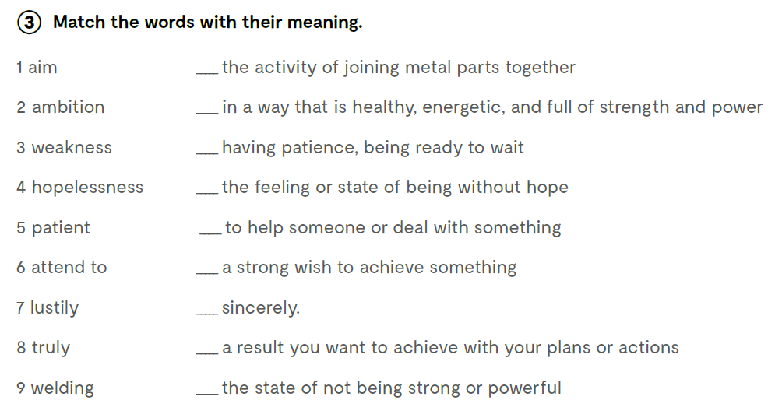
9
7
5
4
6
2
8
1
3
Check what you have learnt. https://wordwall.net/play/13345/860/986

Slide 8

